Slide 1
Emotional Granularity slide deck

Slide 2
Study 1: N = 72
Preregistration: https://osf.io/dtqfr
Tasks:
Granularity task
aMEDT
Questionnaires:
eBMRQ, Music@Home:R, AIMS, GoldMSI, BDI, RDEES
Some completed the STAI + CD.RISC
Others completed SCAARED

Slide 3
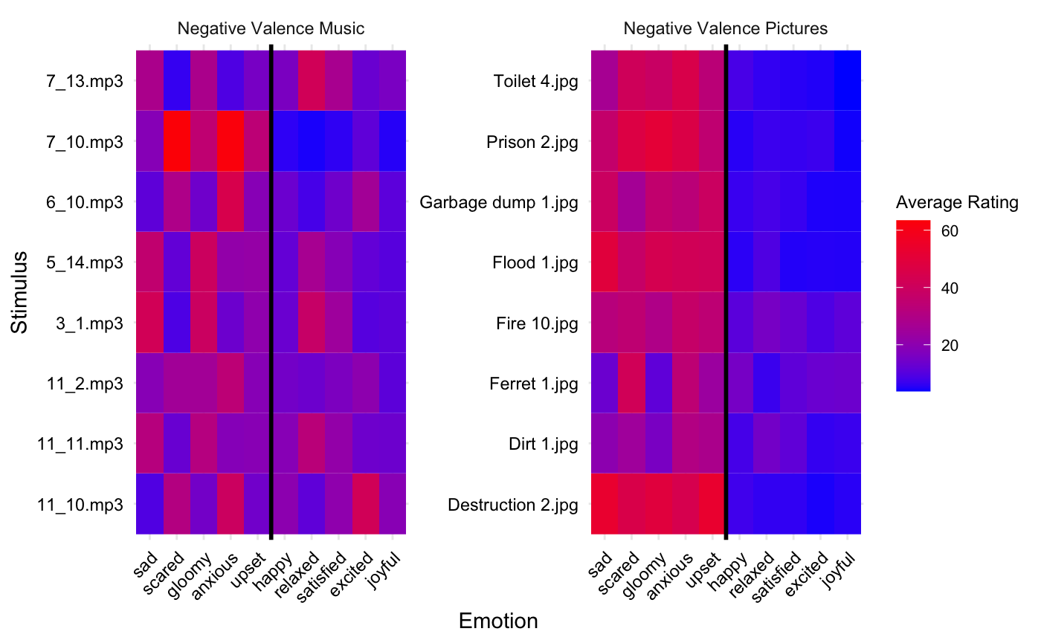
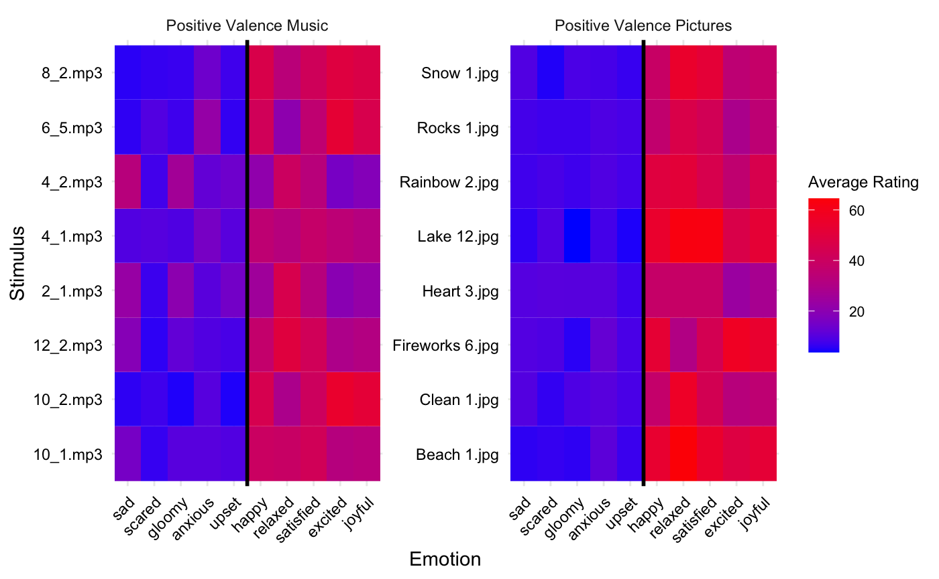
Heatmap of Stimuli Ratings + Emotion Words

Slide 4
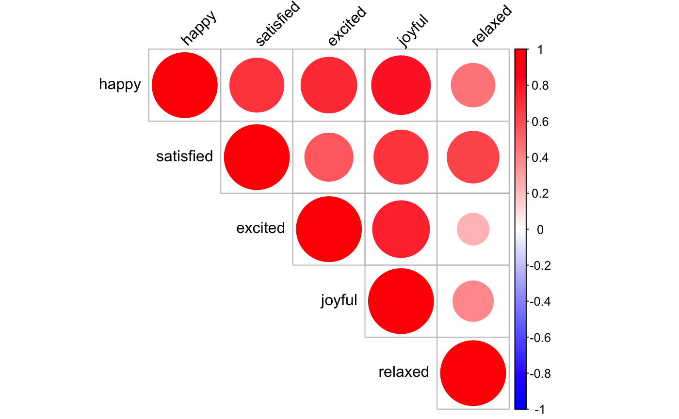
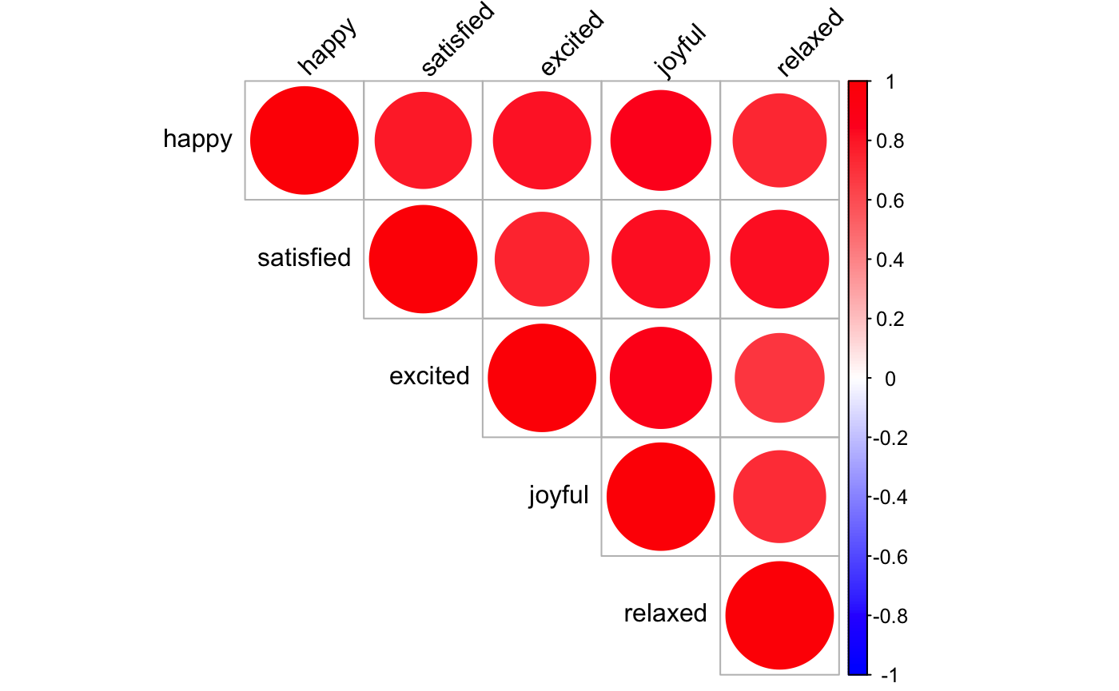
Correlations of Positive Valence Emotion Ratings
Music
Pictures

Slide 5
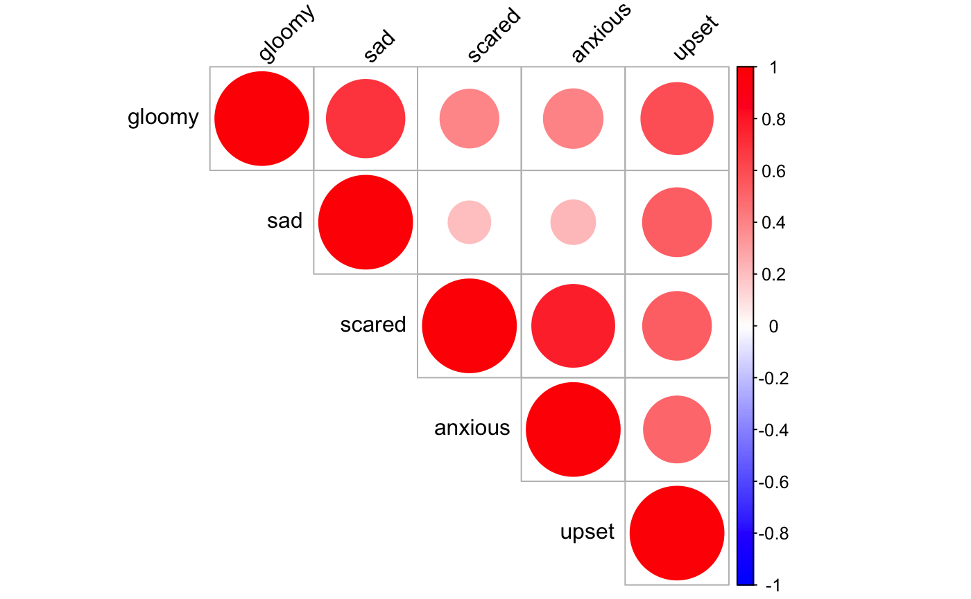
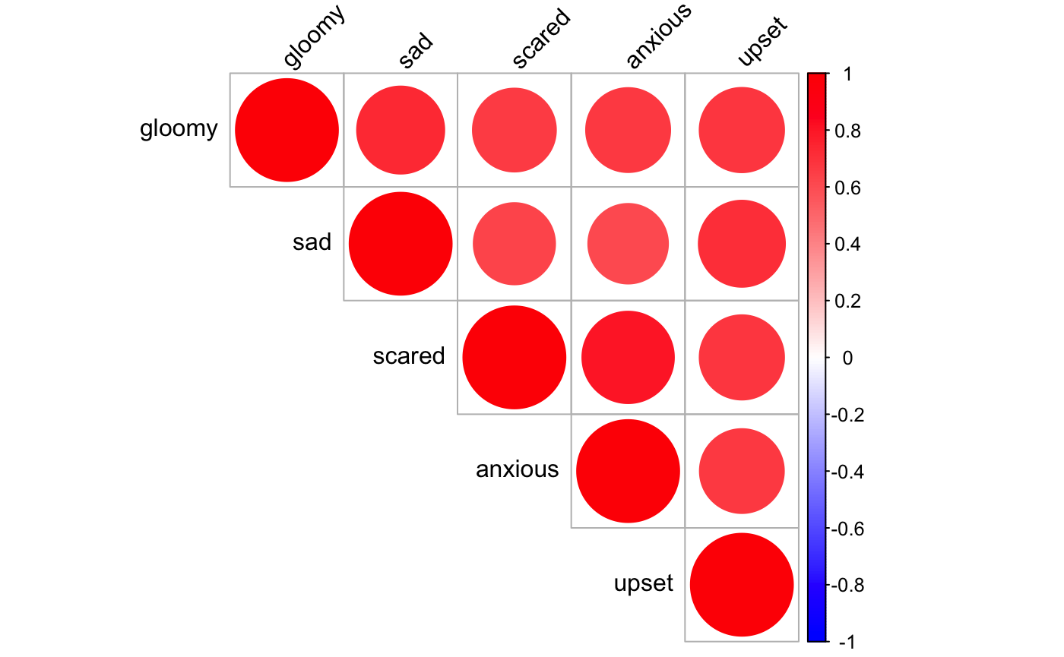
Correlations of Negative Valence Emotion Ratings
Music
Pictures

Slide 6
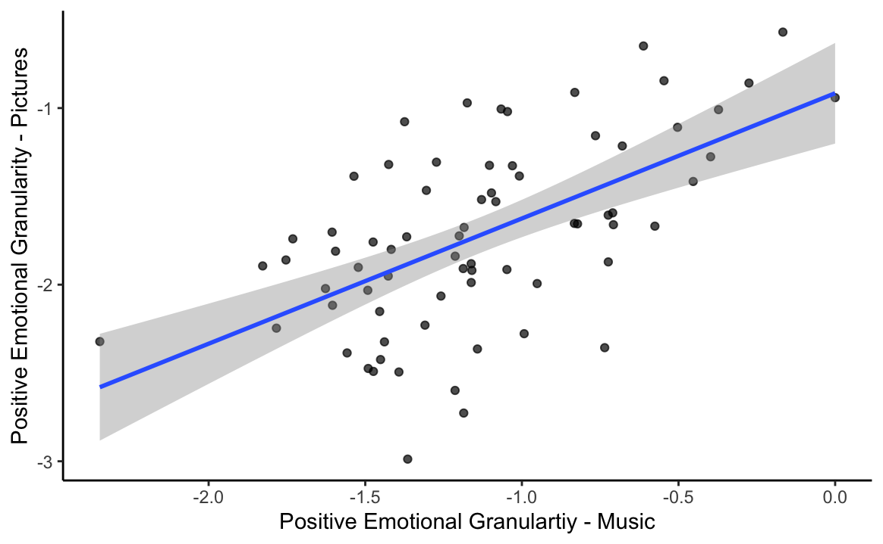
Positive Emotional Granularity for pictures & music are correlated

Slide 7
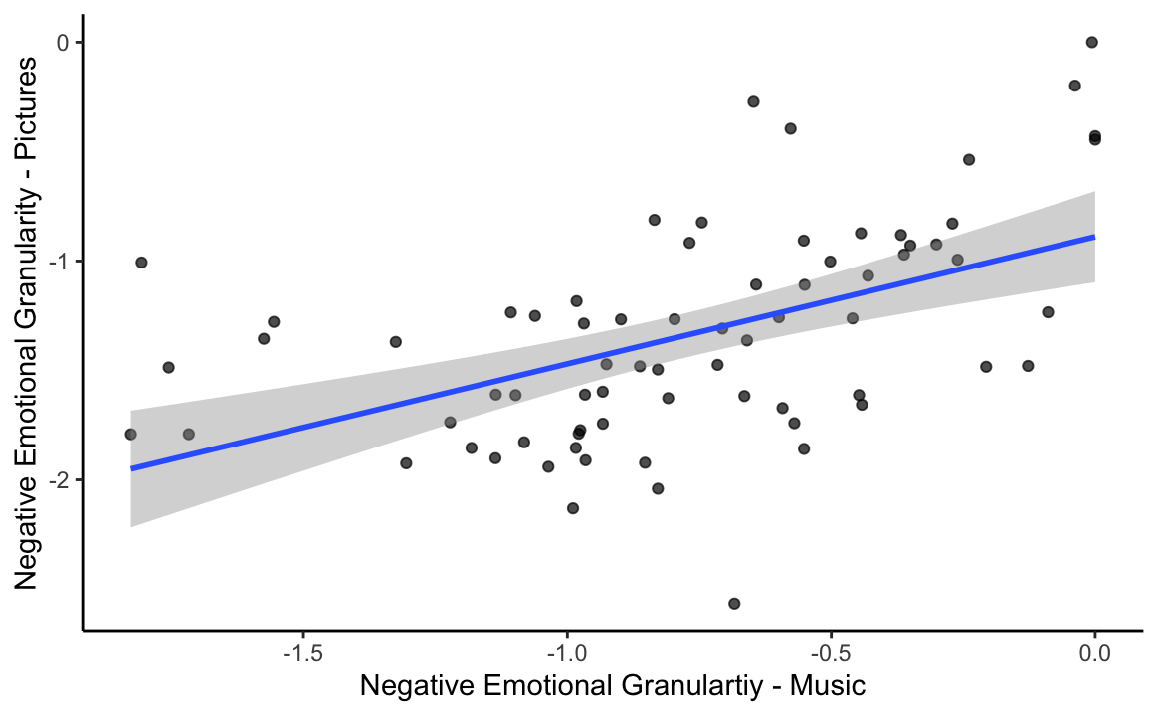
Negative Emotional Granularity for pictures & music are correlated

Slide 8
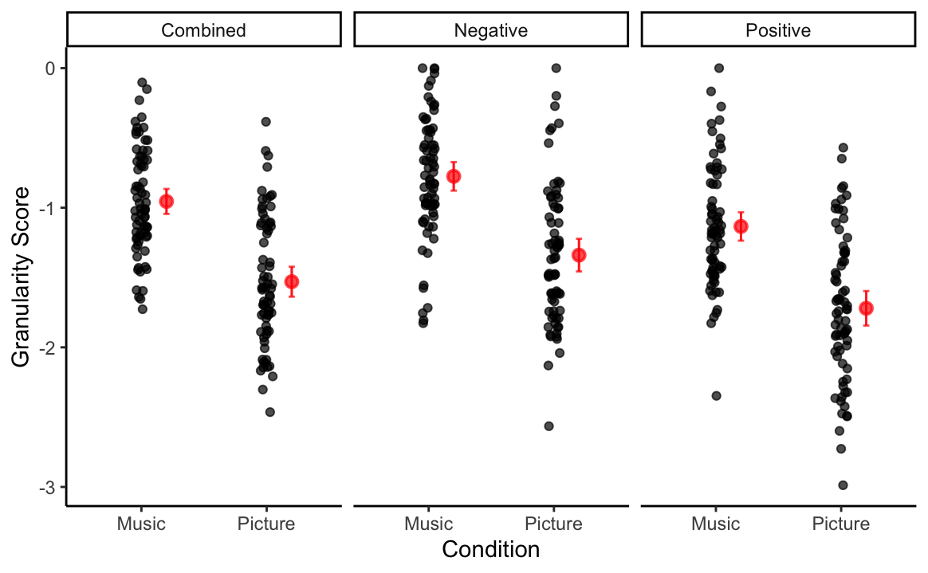
Emotional Granularity is higher for music compared to pictures

Slide 9
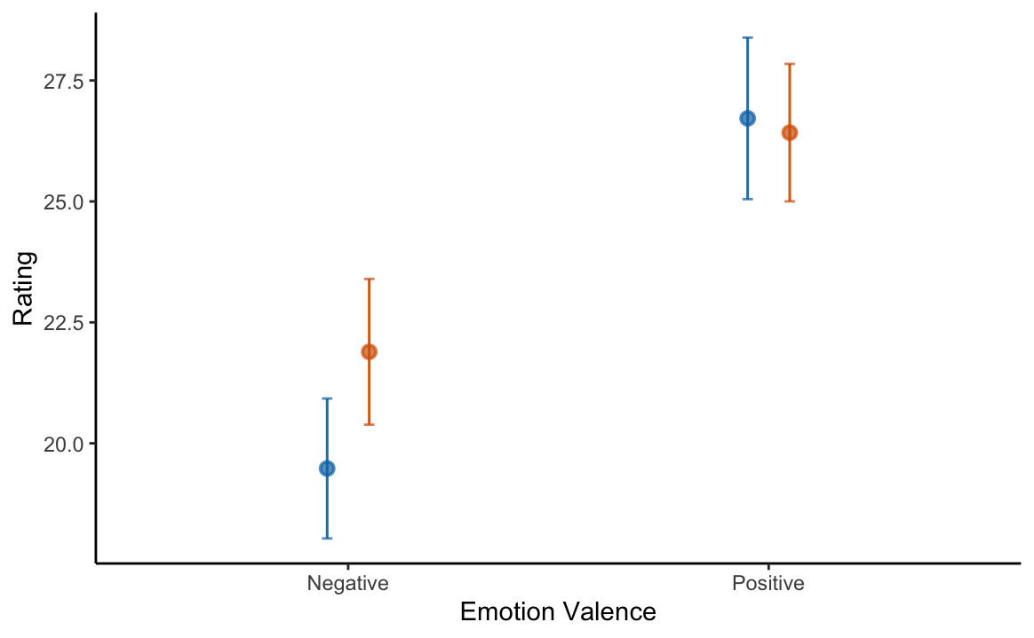
Differences in granularity are not due to greater magnitude of emotions evoked by music
Music
Pictures
Notes:
There is a sig increase in rating of negative emotions in response to pics vs. music

Slide 10
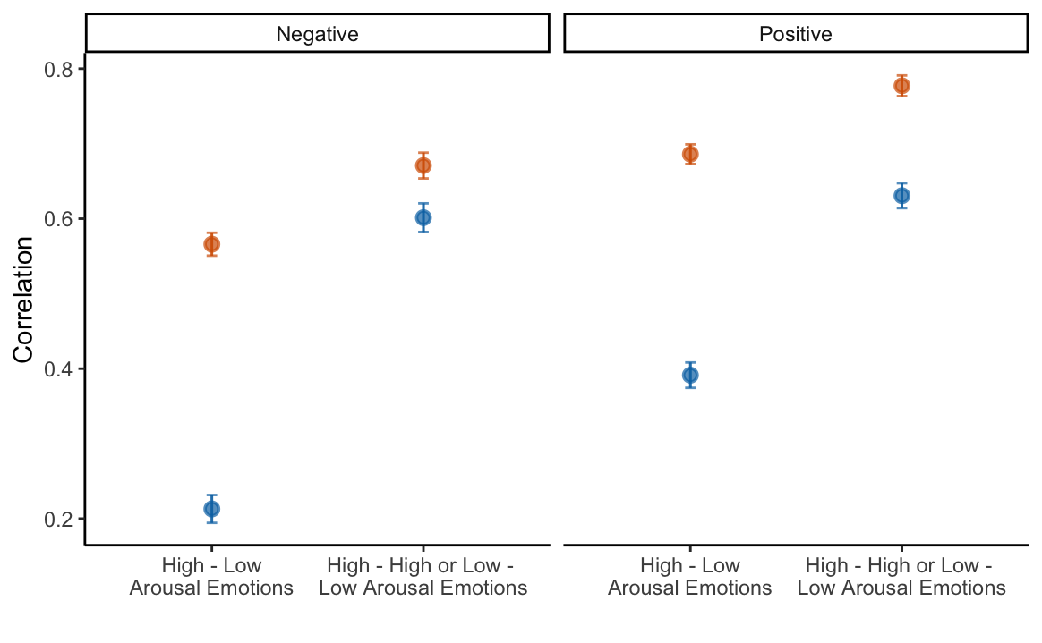
Greater emotional granularity in music may be due to greater arousal-based differentiation
Music
Pictures
Notes:
In other words, participants show a *lower* correlation between emotions that have similar arousal levels while listening to music compared to pictures

Slide 11
Study 2: N = 65
Tasks:
Granularity task
aMEDT
Questionnaires:
eBMRQ, Music@Home:R, AIMS, GoldMSI, BDI, RDEES
Some completed the STAI + CD.RISC
Others completed SCAARED

Slide 12
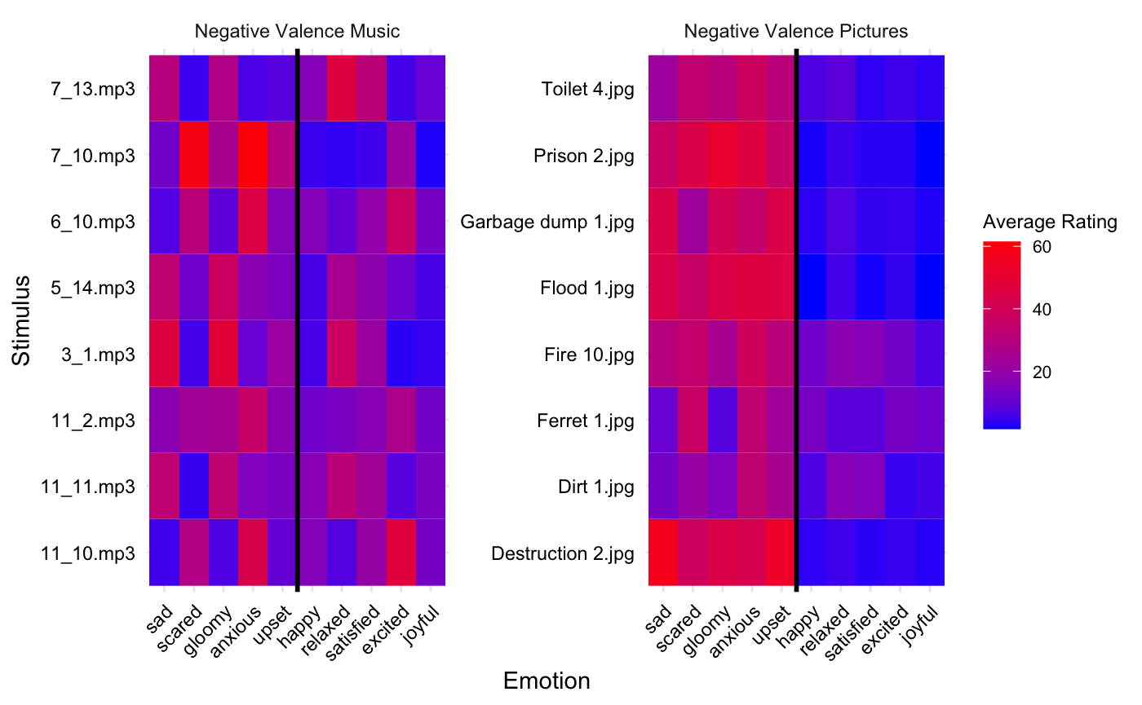
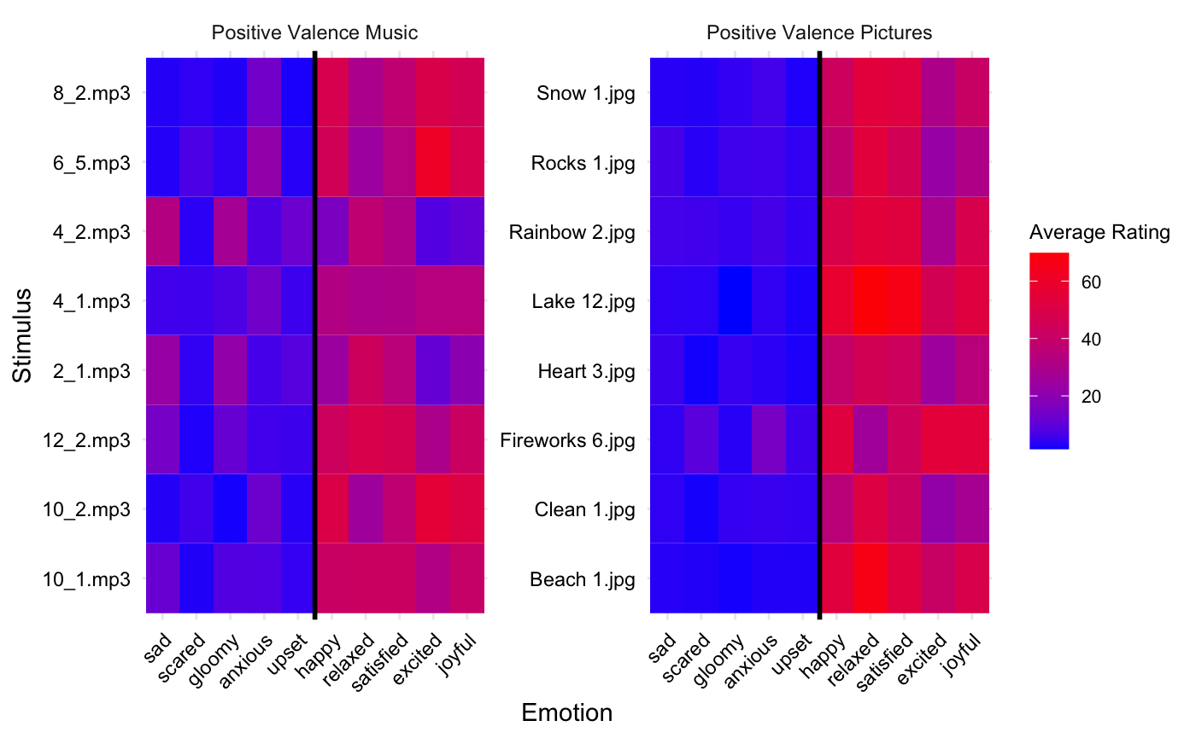
Heatmap of Stimuli Ratings + Emotion Words

Slide 13
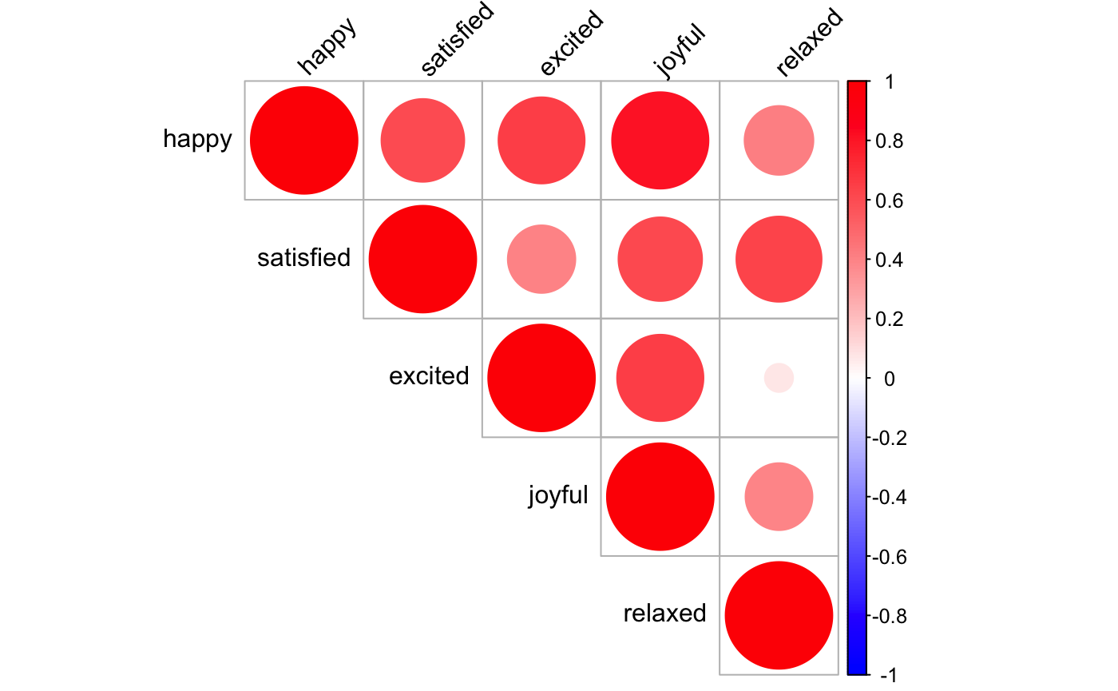
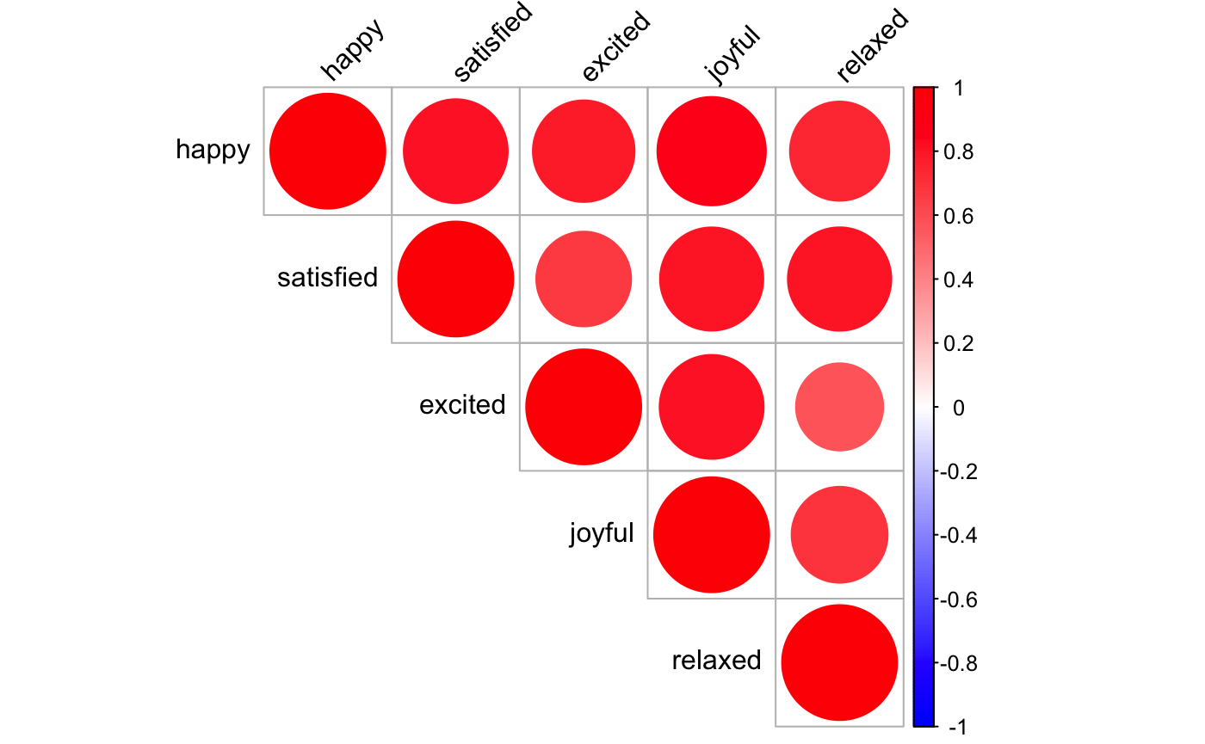
Correlations of Positive Valence Emotion Ratings
Music
Pictures

Slide 14
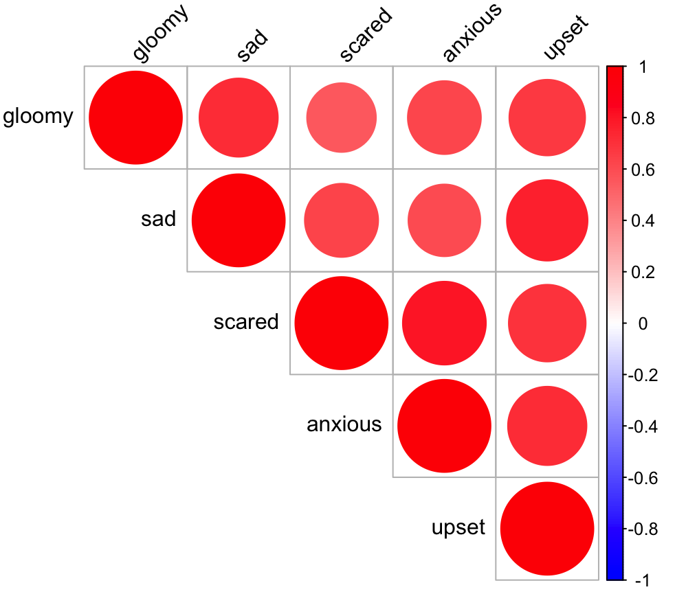
Correlations of Negative Valence Emotion Ratings
Music
Pictures

Slide 15
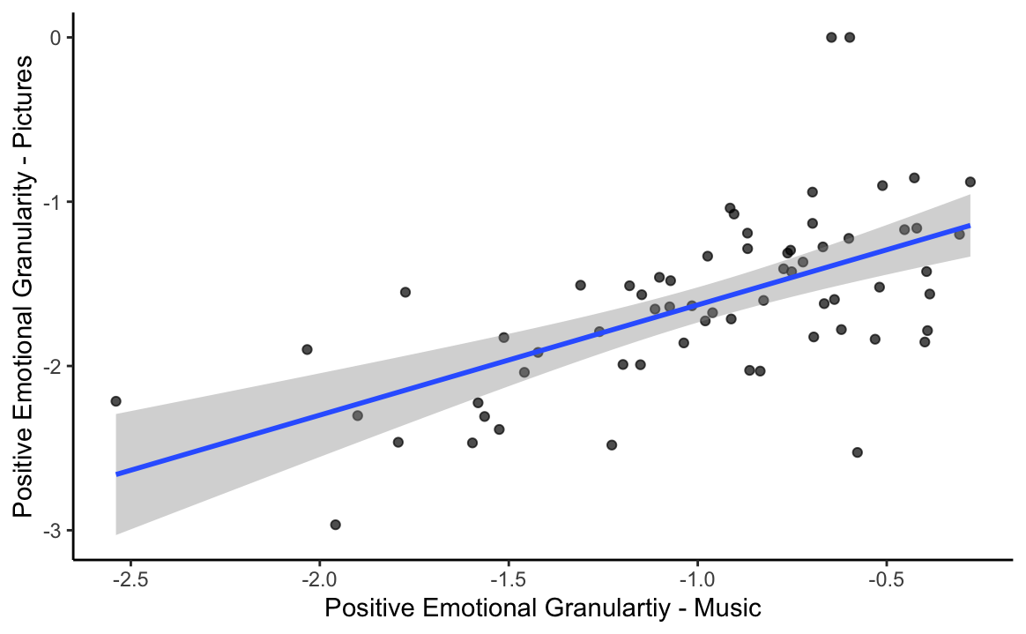
Positive Emotional Granularity for pictures & music are correlated

Slide 16
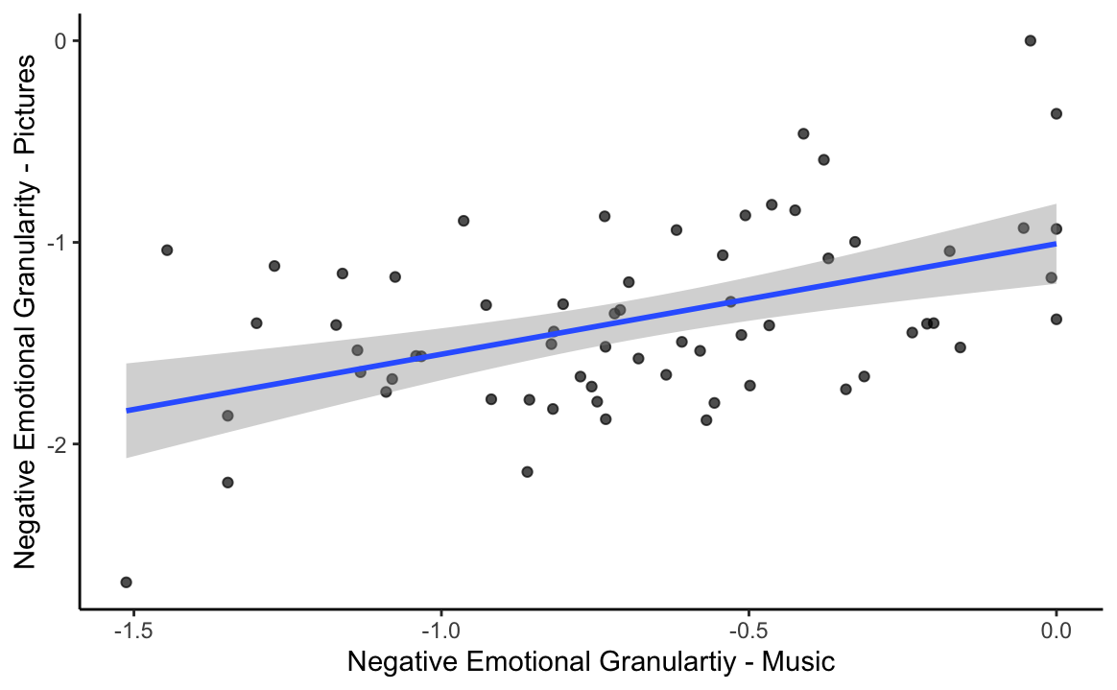
Negative Emotional Granularity for pictures & music are correlated

Slide 17
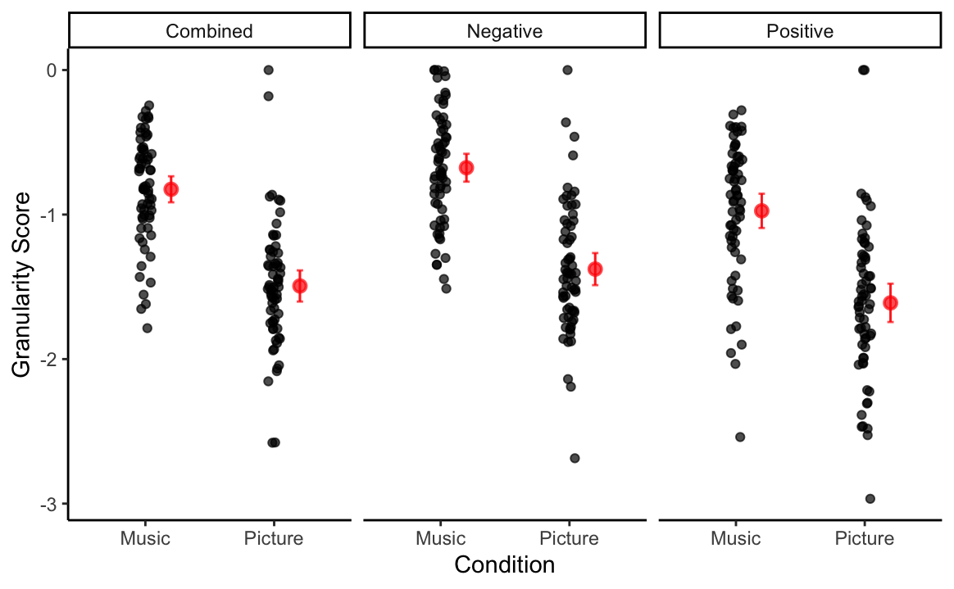
Emotional Granularity is higher for music compared to pictures

Slide 18
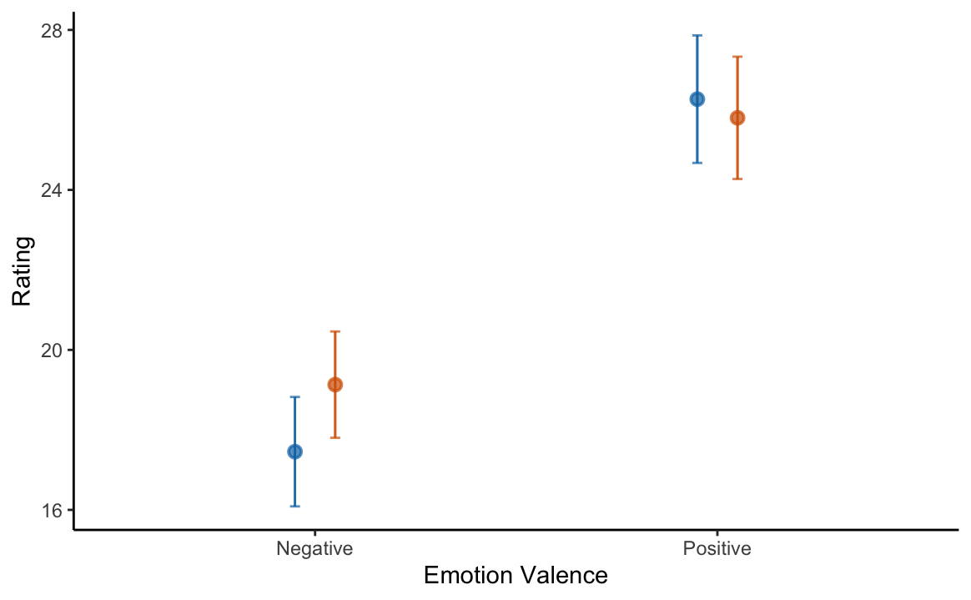
Differences in granularity are not due to greater magnitude of emotions evoked by music
Music
Pictures

Slide 19
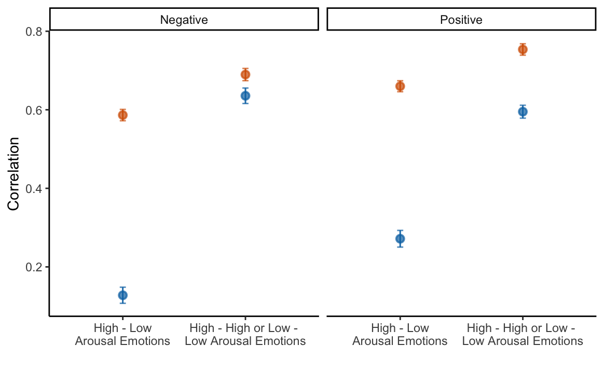
Greater emotional granularity in music may be due to greater arousal-based differentiation
Music
Pictures

Slide 20
Across-study analyses: aMEDT + survey measures

Slide 21
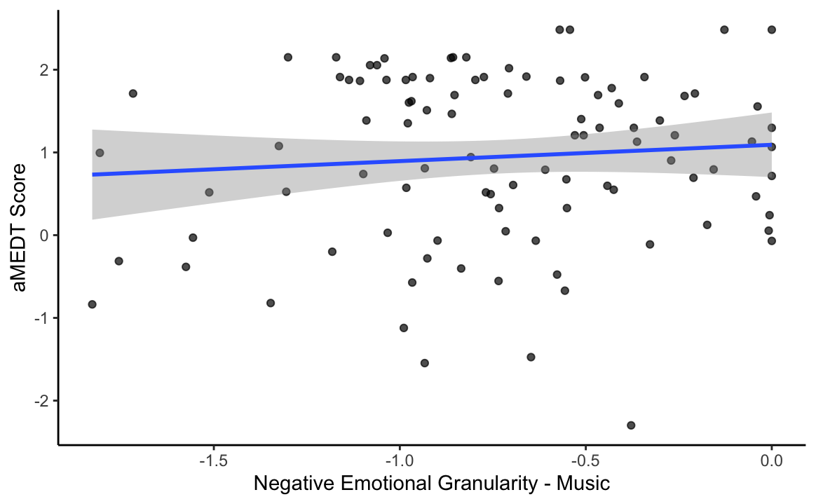
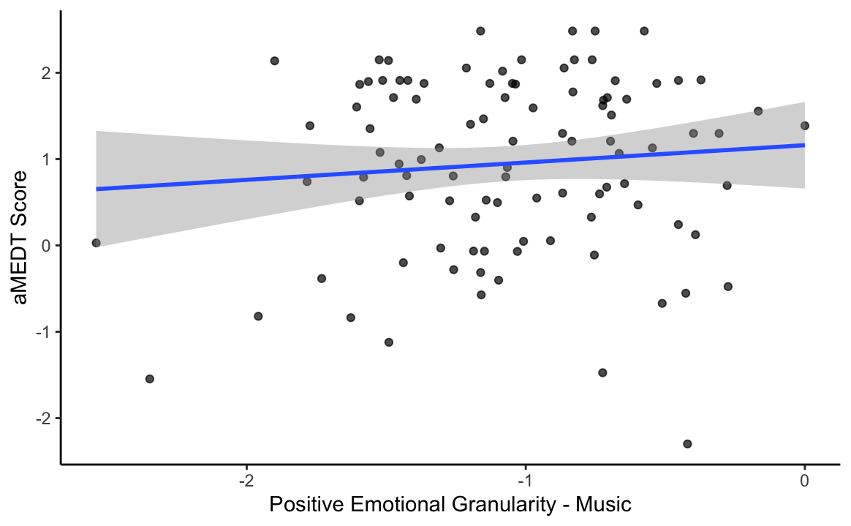
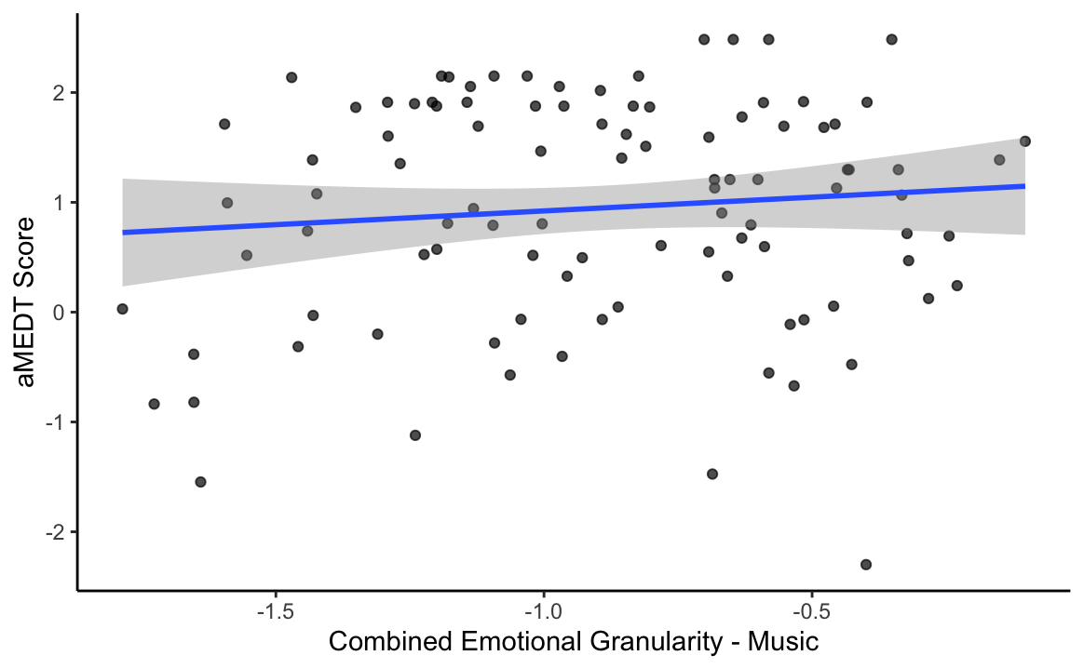
The ability to discriminate emotions in music is not related to emotional granularity in music

Slide 22
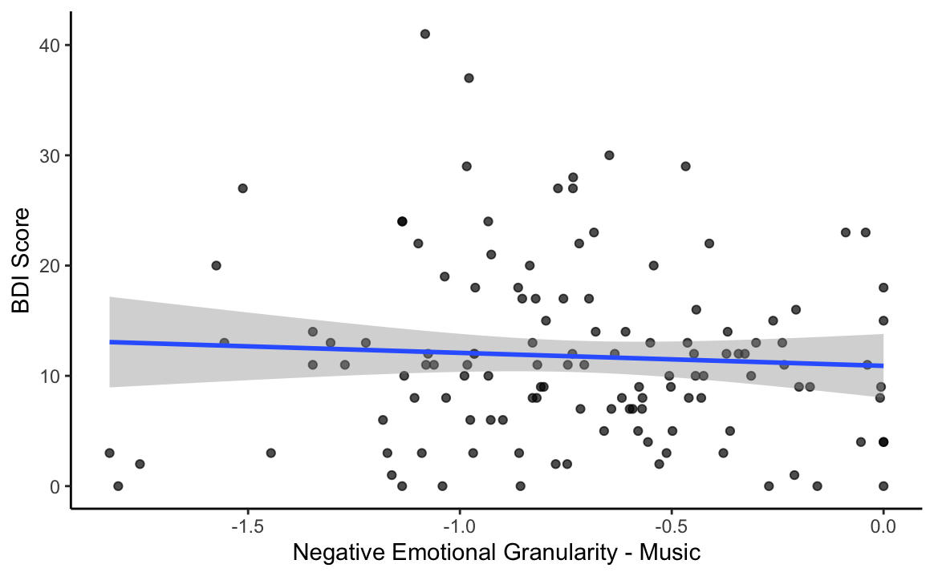
Negative emotional granularity (music) is not related to BDI

Slide 23
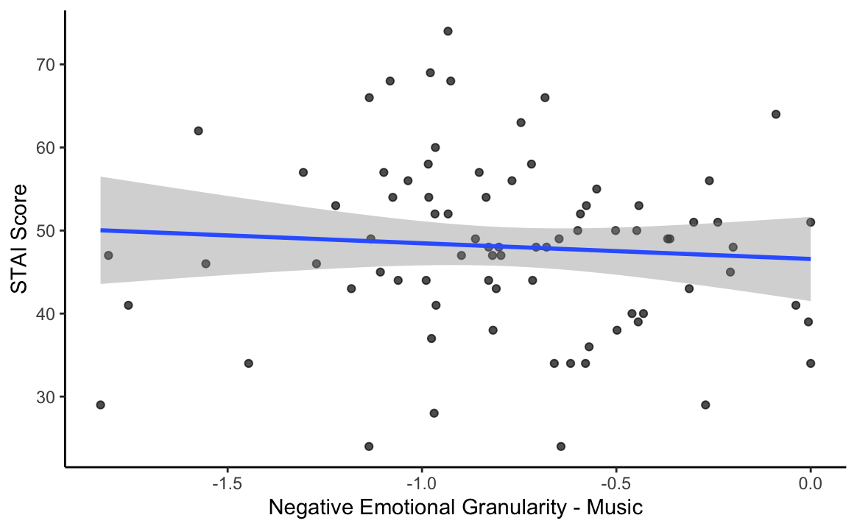
Negative emotional granularity (music) is not related to STAI

Slide 24
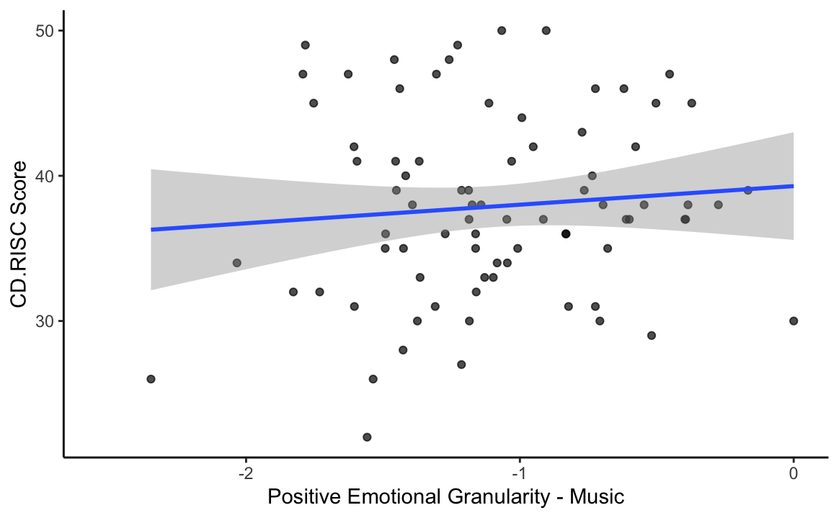
Positive emotional granularity (music) is not related to CD.RISC

Slide 25
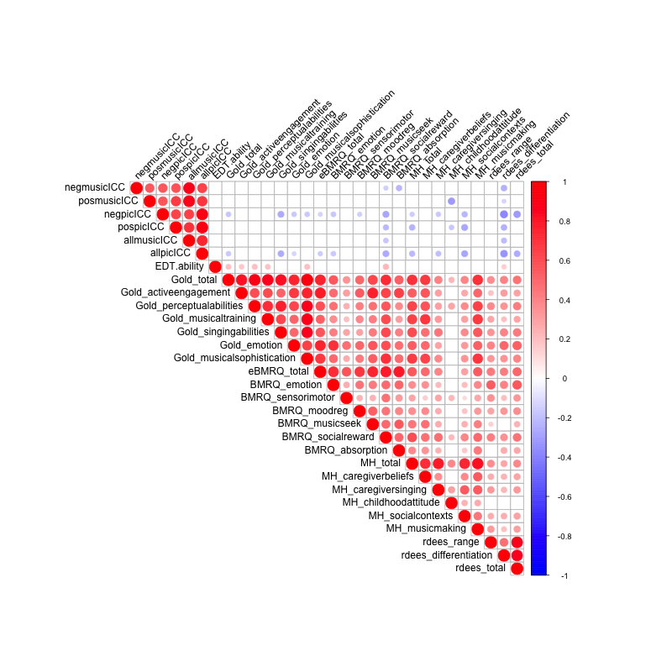
Correlations among other survey measures not mentioned in pre-registration
Notes:
Notable correlations: EDT + rdees differentiation, neg. correlation between rdees + granularity all around (?), M@H + rdees (though rdees seems to be correlated w/ nearly every self-report measure)

Slide 26
Paper Figures

Slide 27
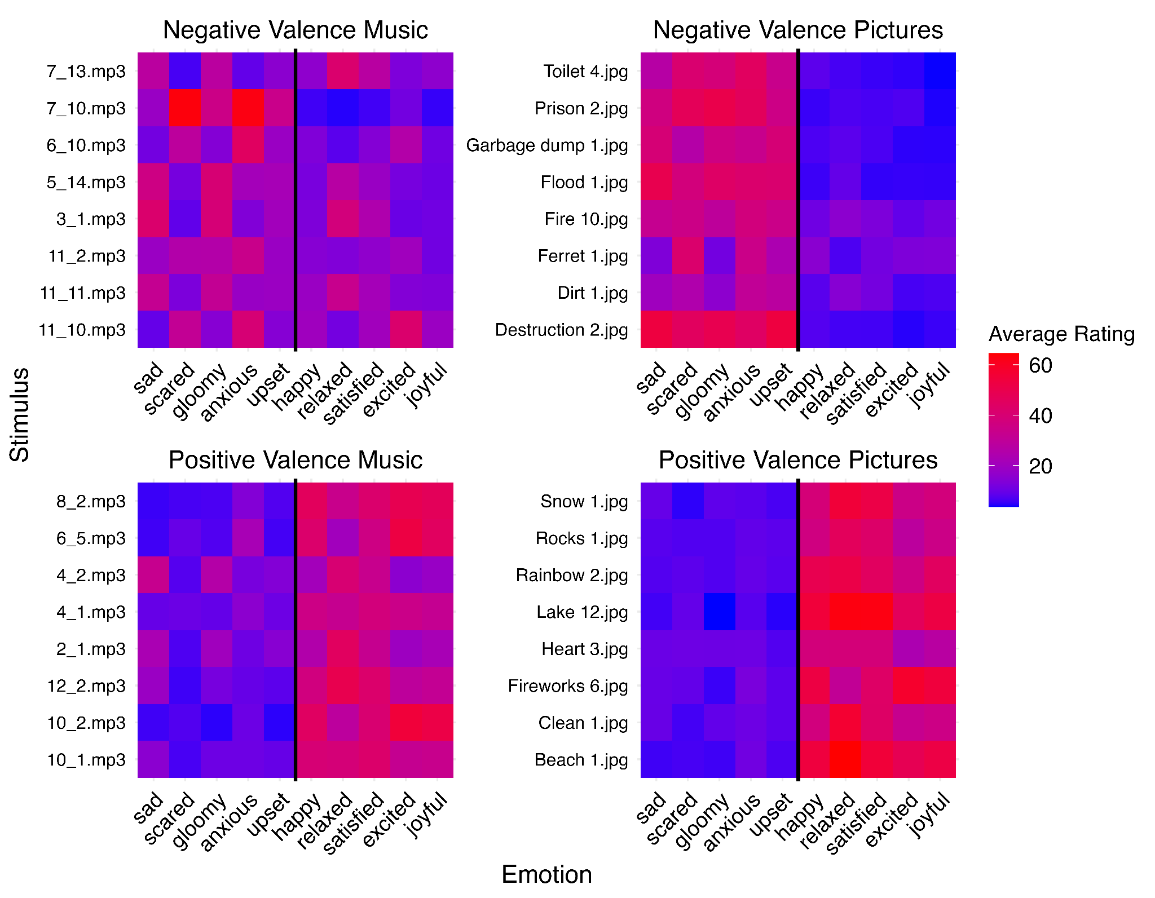
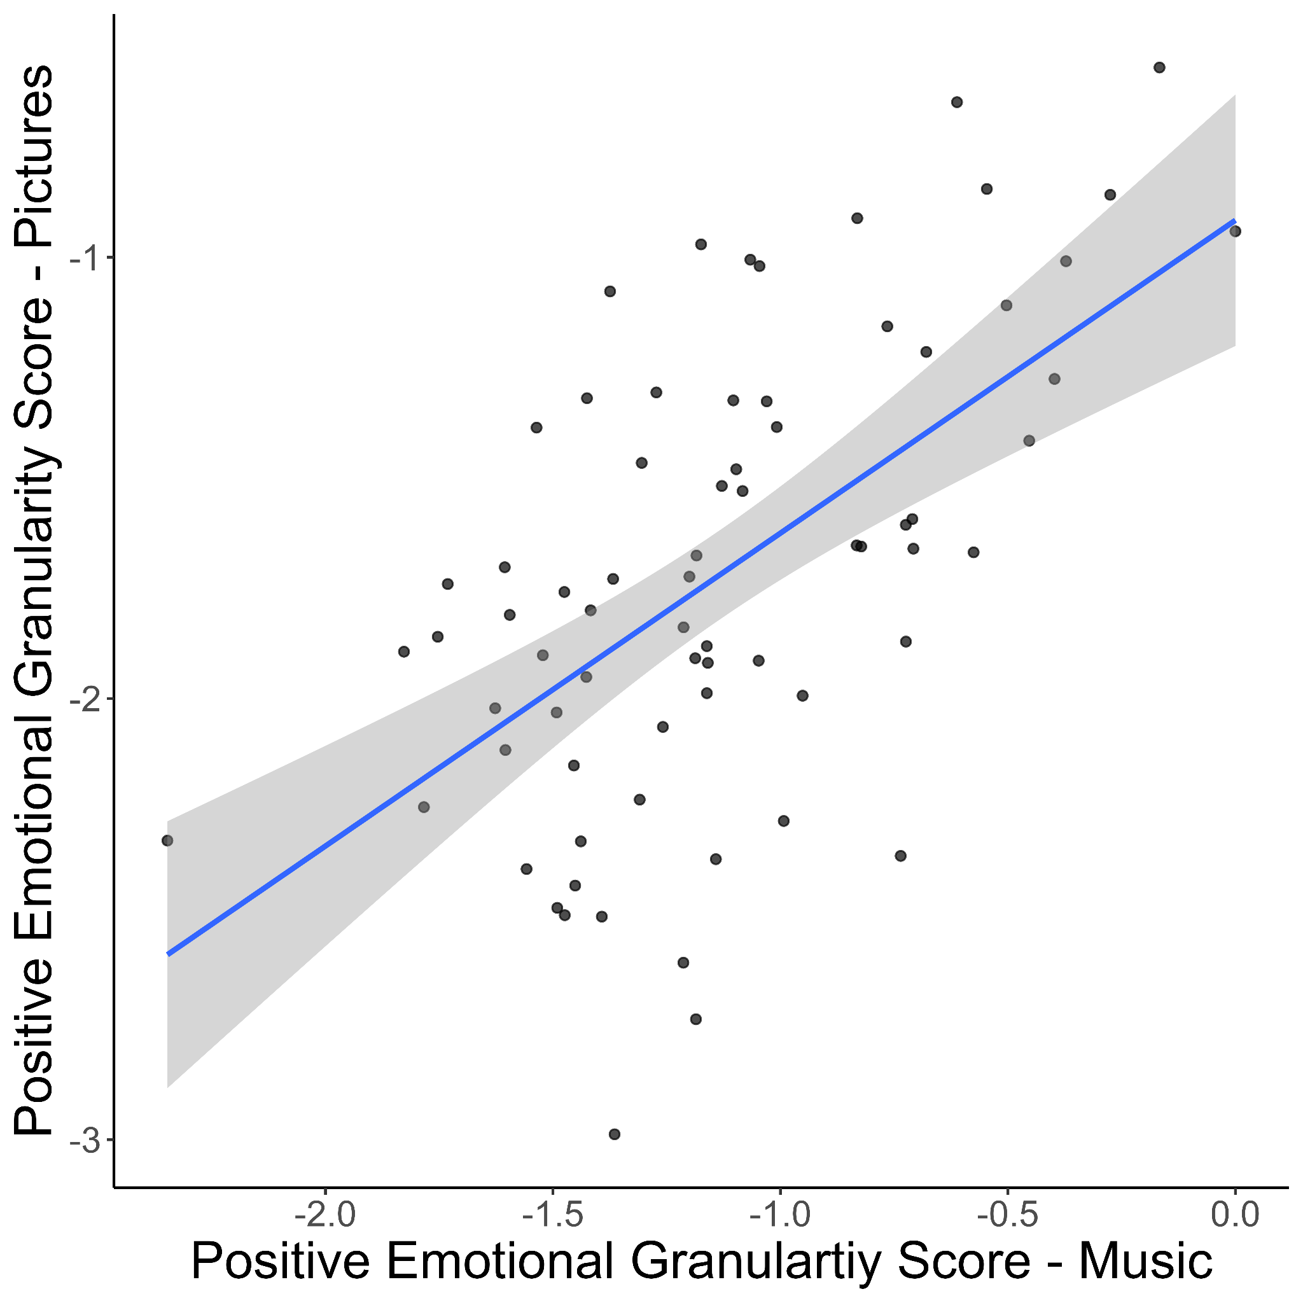
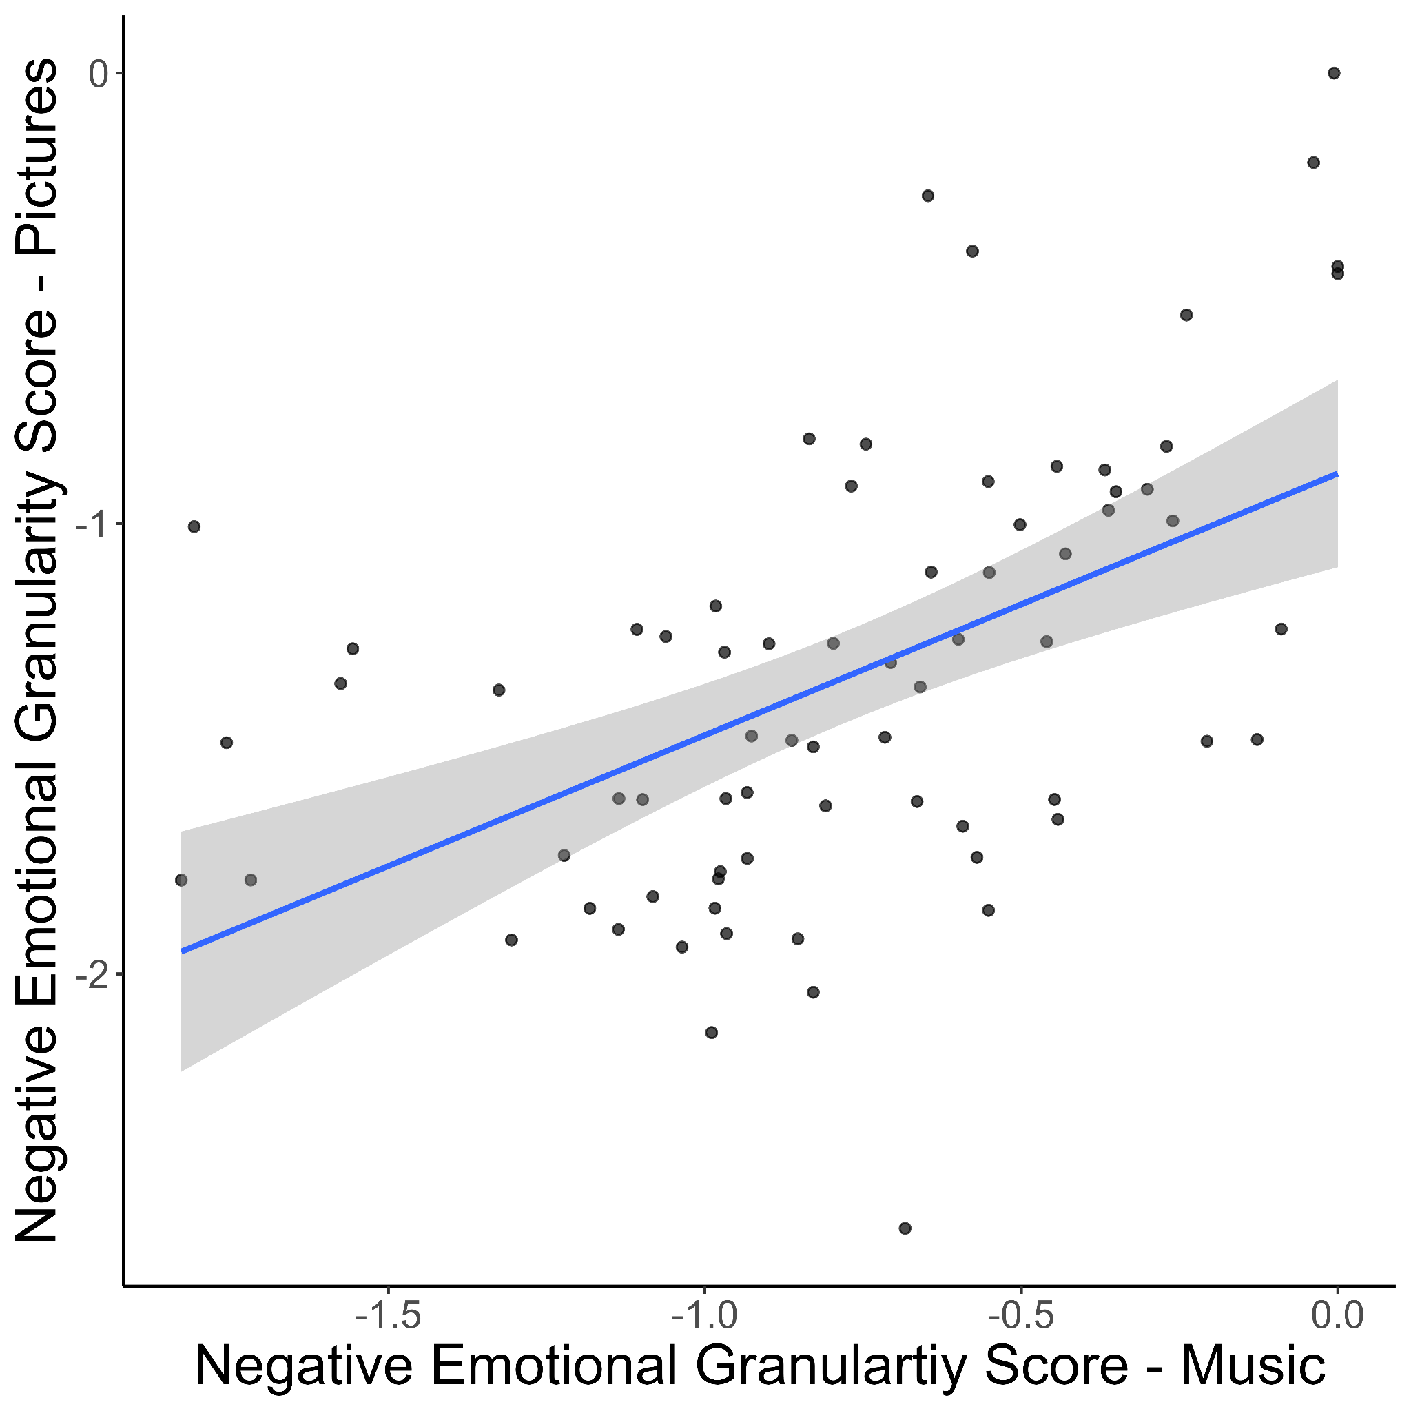
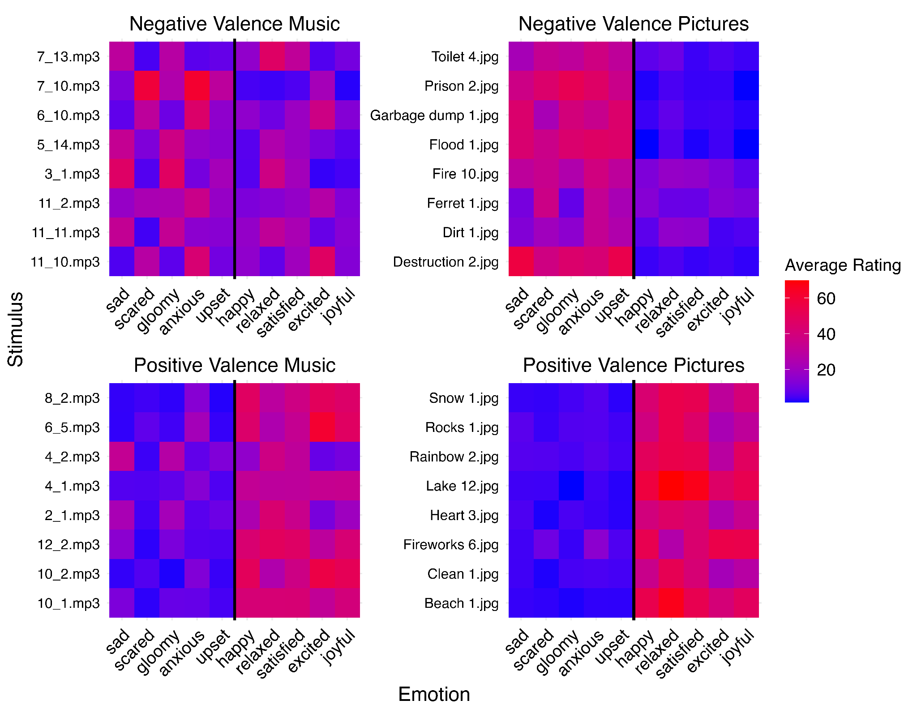
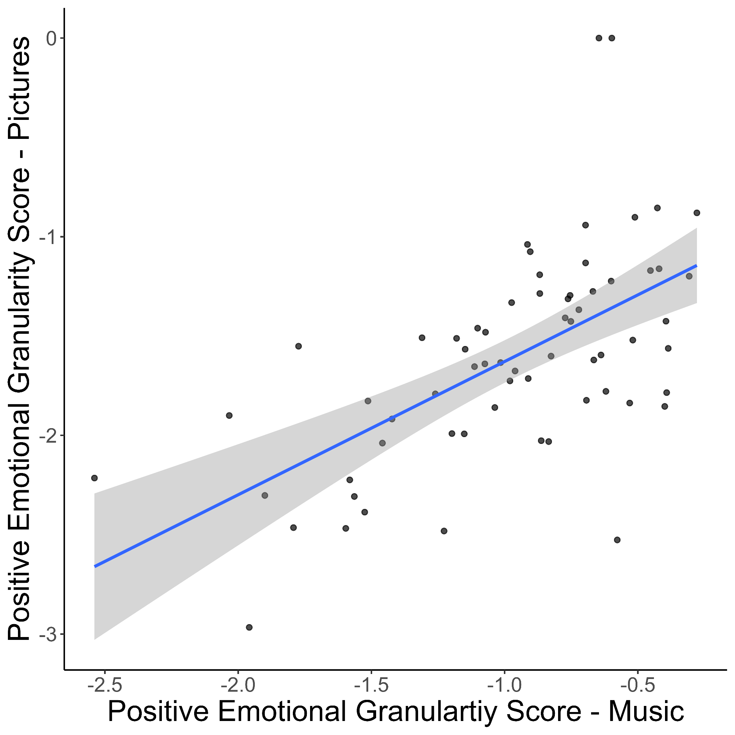
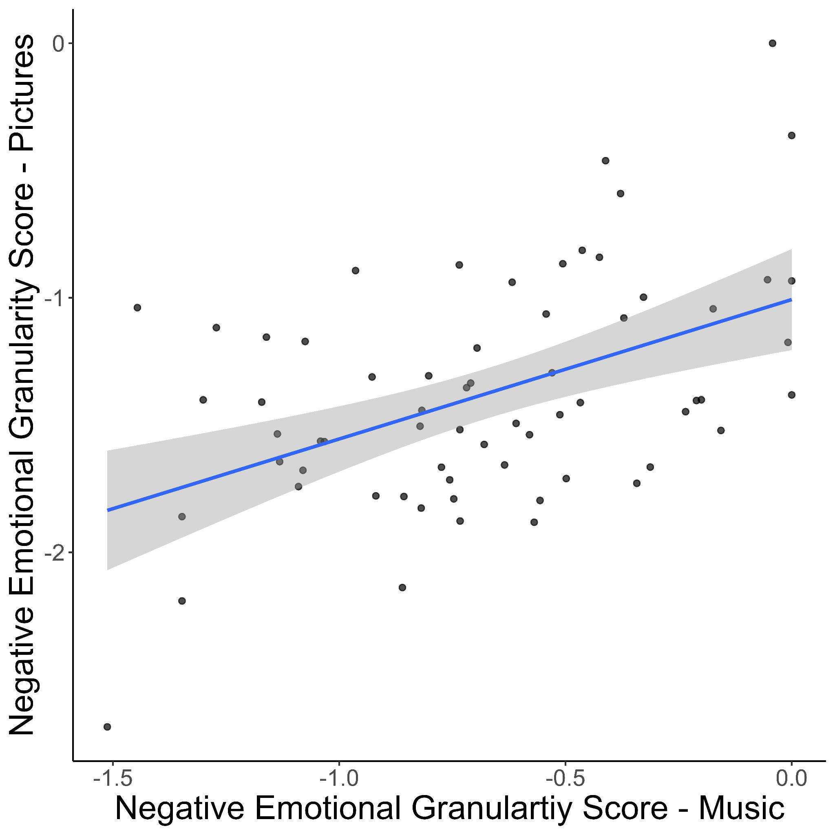
A)
B)
C)
Study 1
D)
E)
F)
Study 2
r = 0.58***
r = 0.51***
r = 0.65***
r = 0.62***

Slide 28
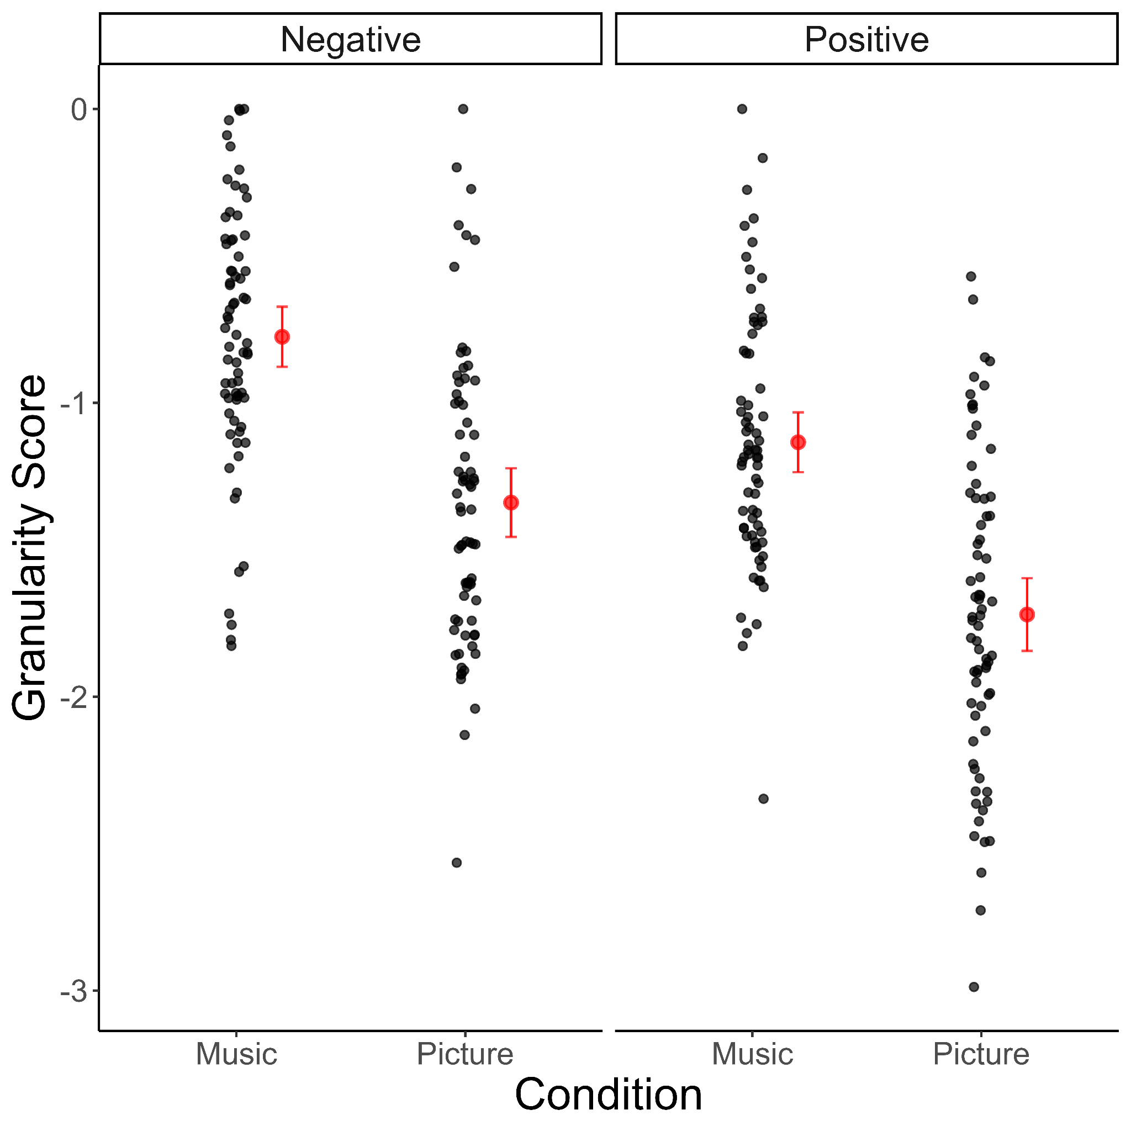
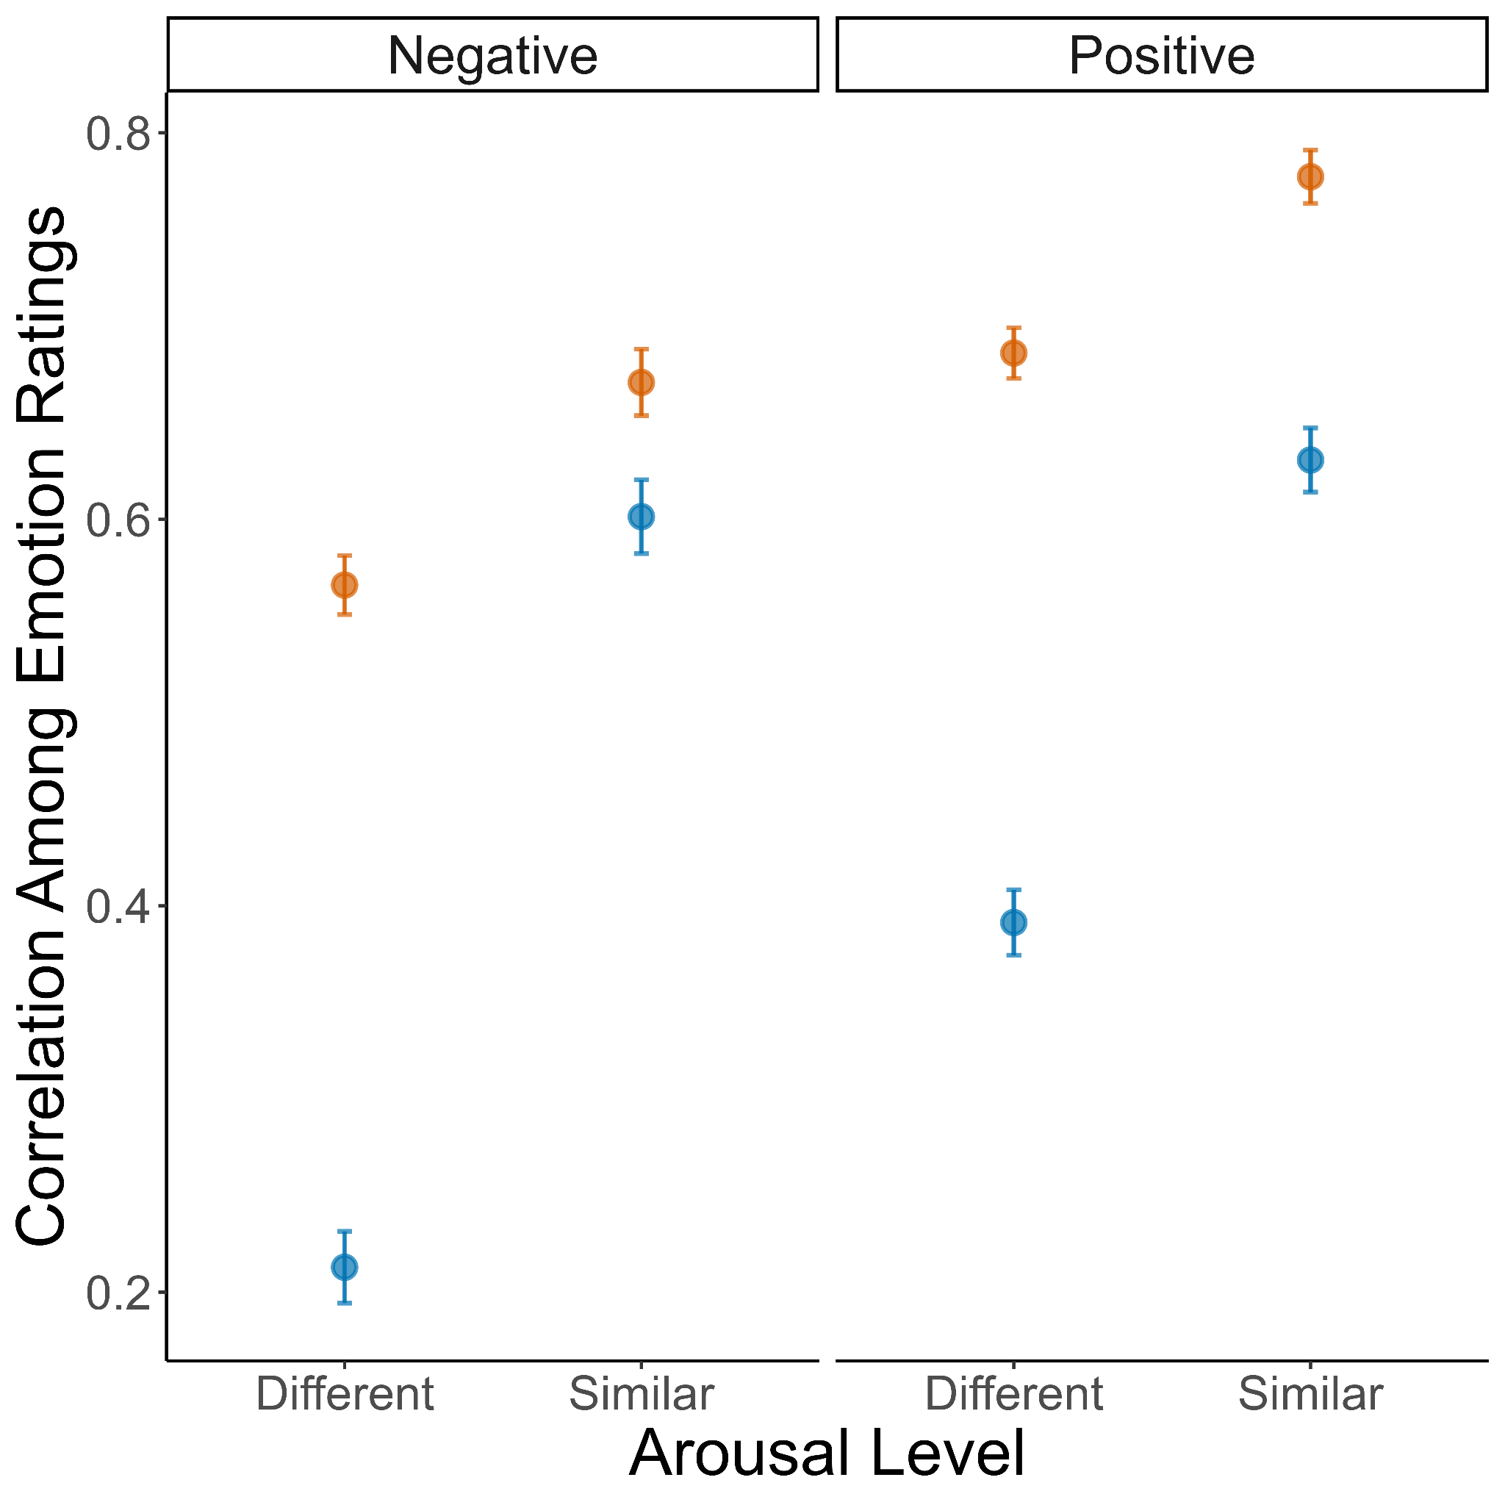
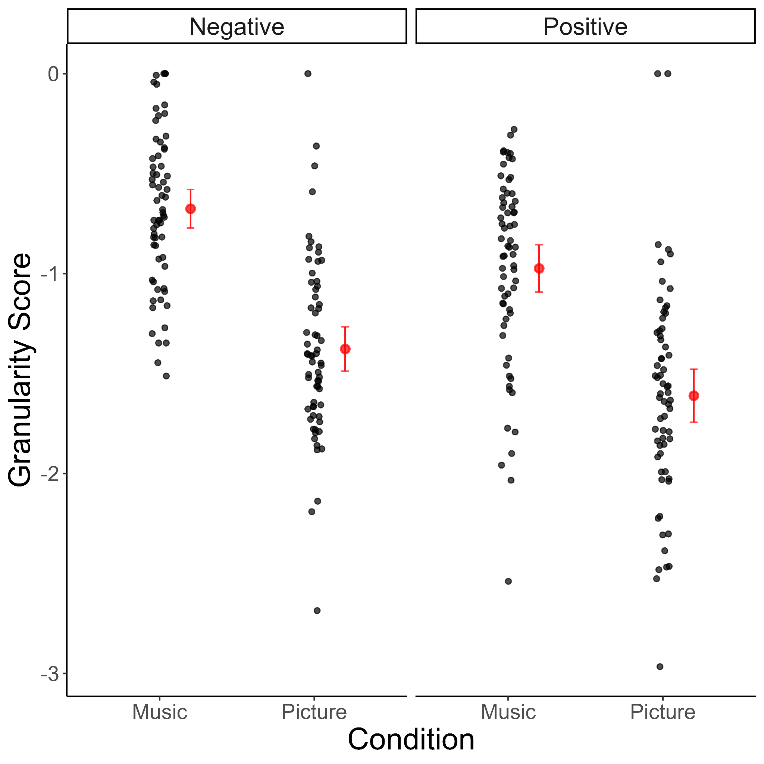
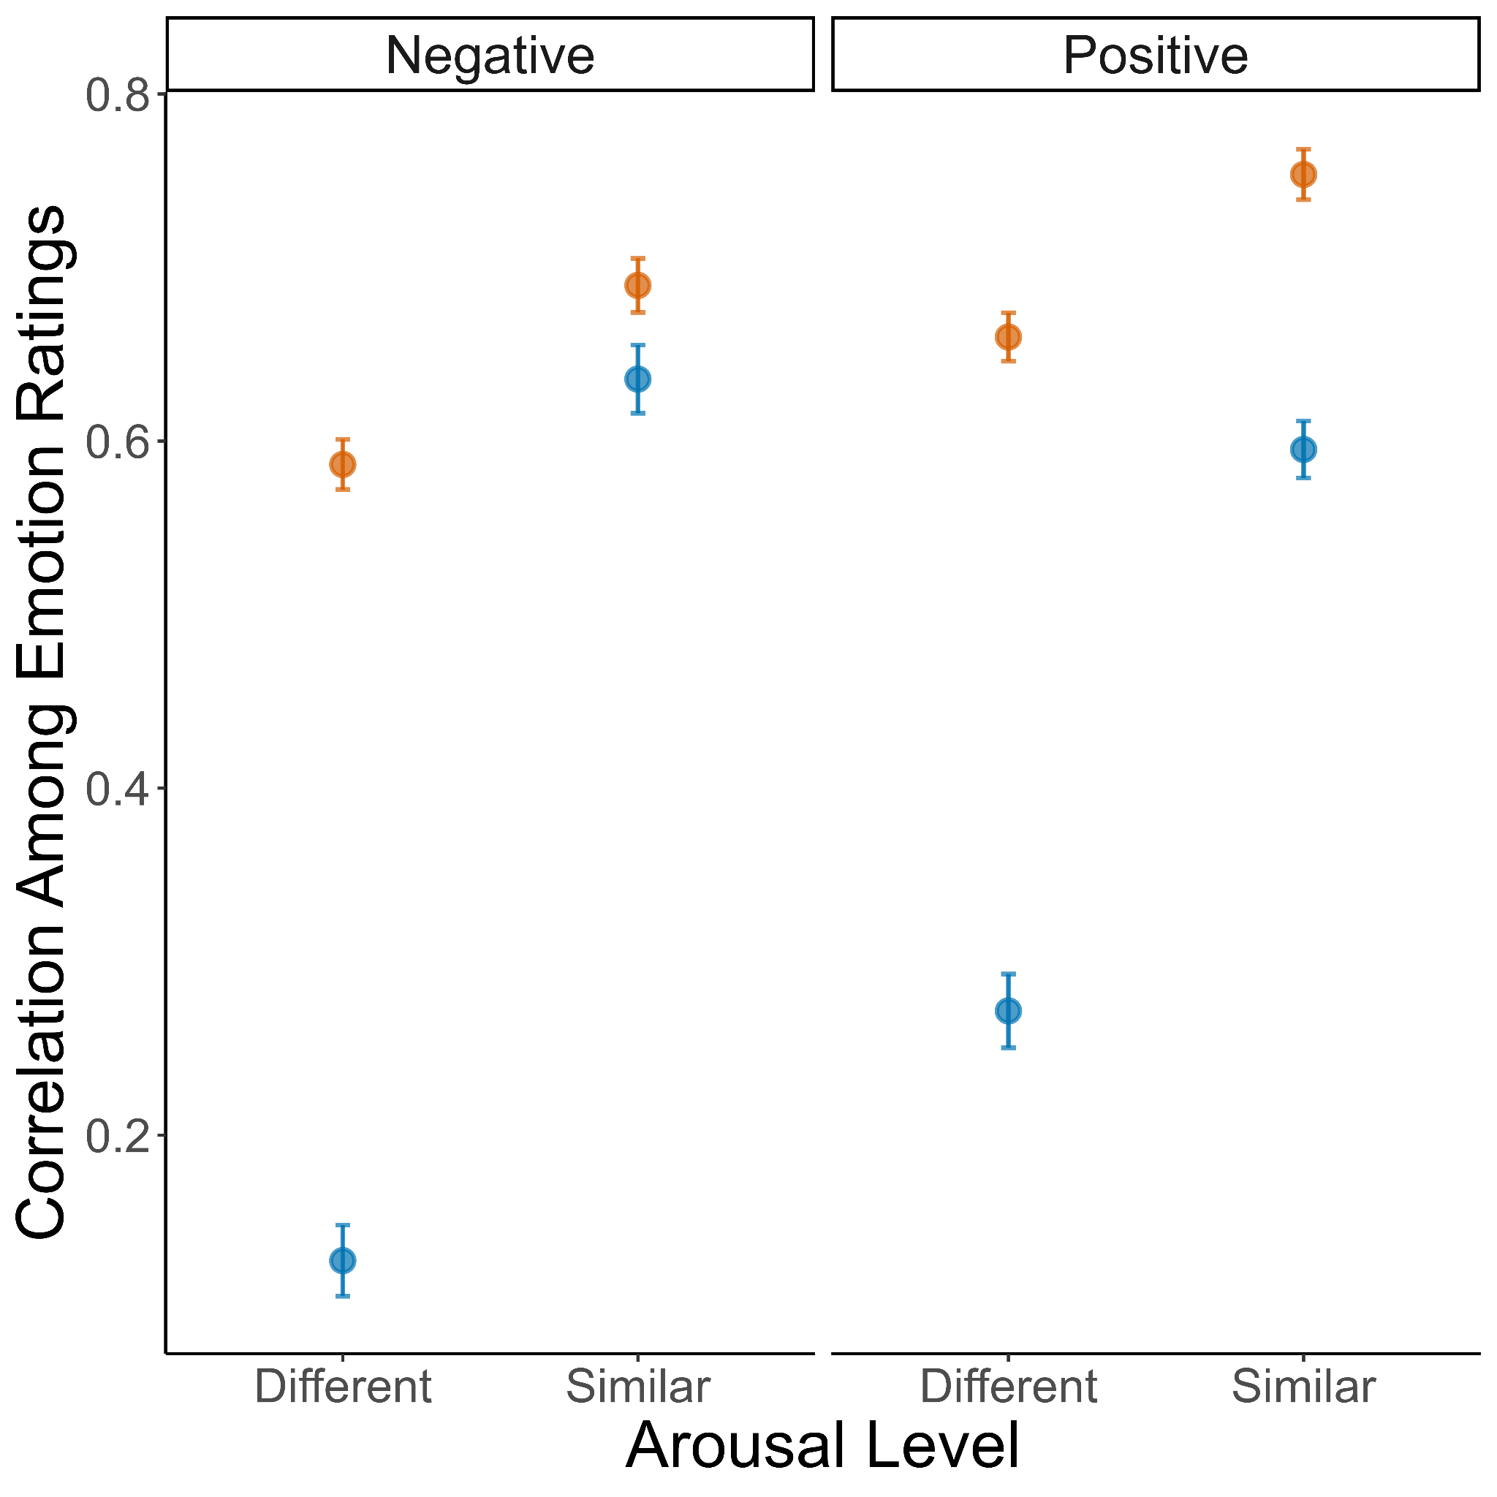
A)
B)
Study 1
C)
D)
Study 2
Pictures
Music

